Slide 1

Basic Details of the Team and Problem Statement
Ministry/Organization Name/Student Innovation:
National Technical Research Organisation,(NTRO)
PS Code: SIH1447
Problem Statement Title: Identification and Extraction of Forward Error Correction(FEC) Schemes of unknown demodulated signals
Team Name: Innovation Alteers
Team Leader Name: A Sai Kavya
Institute Code (AISHE): IC202014406
Institute Name: G. Pulla Reddy Engineering College (Autonomous)
Theme Name: Miscellaneous

Slide 2
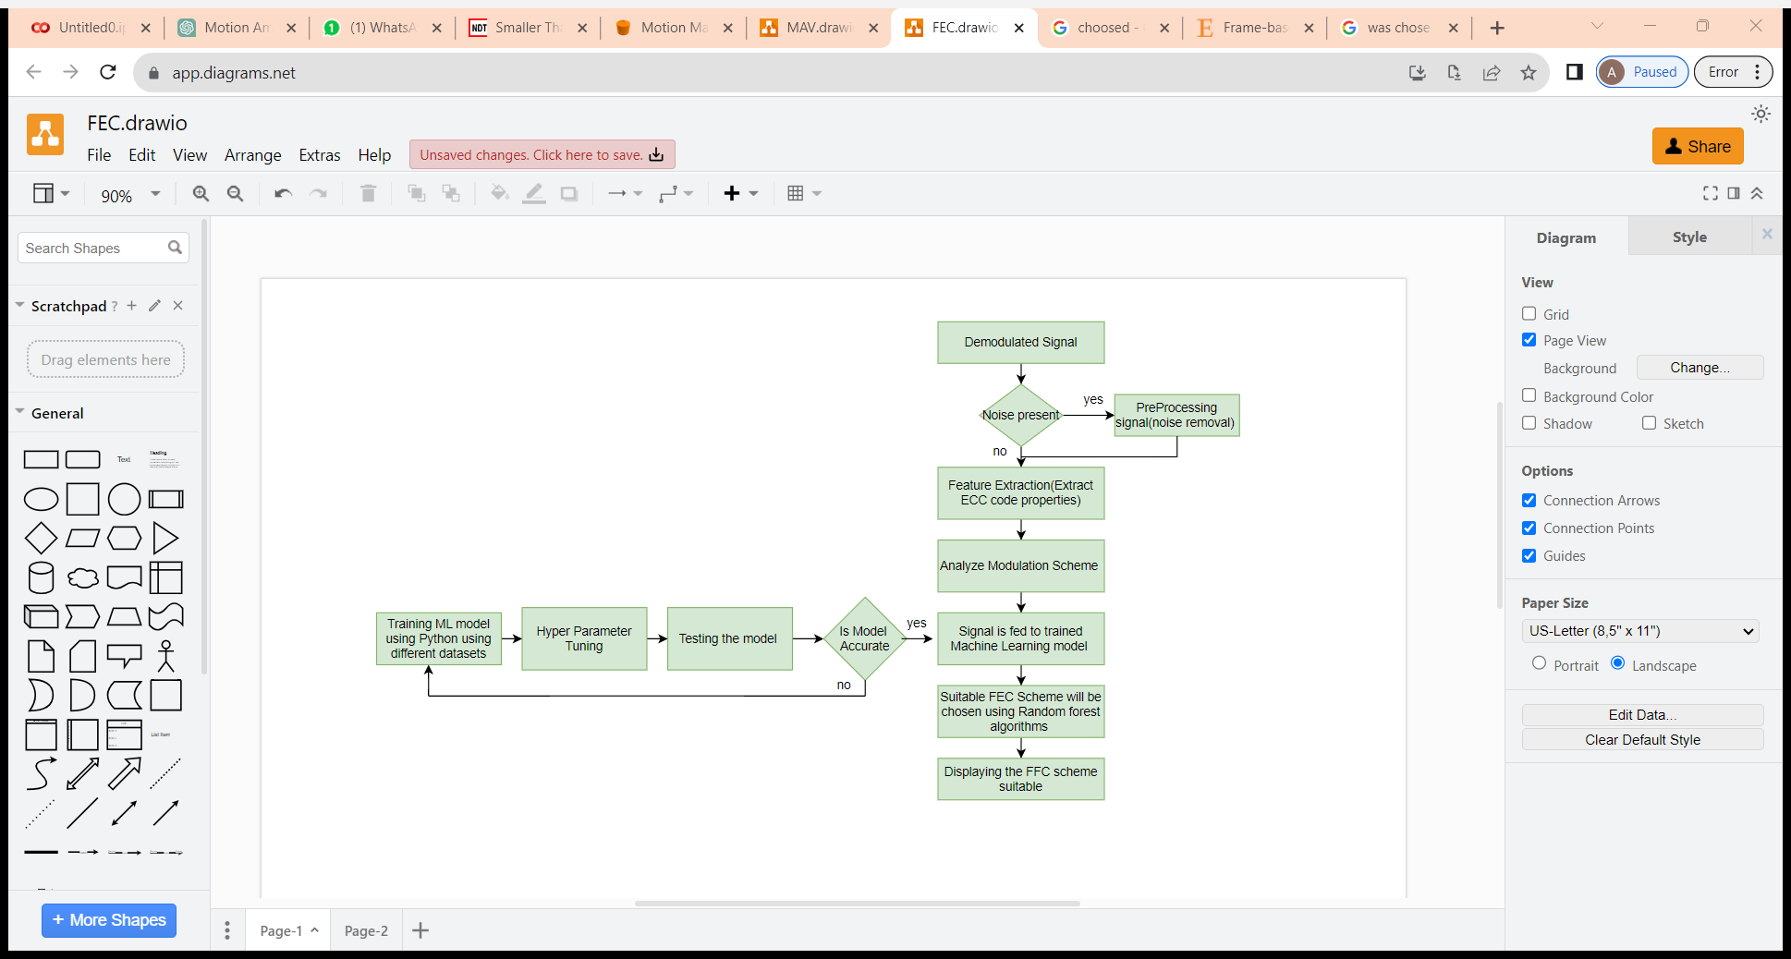
Identification and Extraction of FEC Schemes
We propose a Machine Learning Based tool to identify FEC Scheme of an unknown demodulated signal:
Integrating Signal Processing and Machine Learning Techniques for robust communication analysis
Based on different parameters of demodulated signal we can extract the FFC scheme
The technologies we use are:
➔Wavelet Denoising (To remove noise)
➔Machine Learning Algorithms like Neural networks( to train the model), random forest(to decide best scheme)

Slide 3
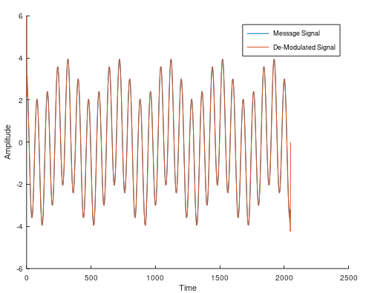

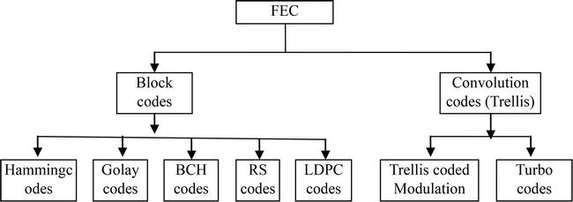
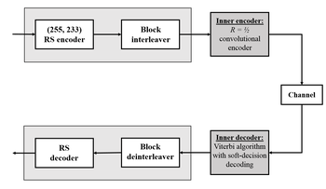
SAMPLE SCENARIO
An example to understand our project:
When an unknown demodulated signal is fed to our tool, the characteristics were observed:
1.Signal is modulated using QPSK
2.Block length of 255 symbols out of which 223 symbols are data symbols and 32 parity symbols
3.Frequency Spectrum- 1.5GHz to 1.6GHz in L band range
4.Noise Characteristics: Moderate Additive White Gaussian Noise with SNR: 10dB
So based on above parameters the tool will identify the best suitable scheme as Reed – Solomon FFC
Unknown demodulated signal
Analysing the signal (ML)
Selecting one suitable scheme from extracted parameters
Fig.Reed-Solomon block diagram

Slide 4
Team Member Details
Team Leader Name: A SAI KAVYA
Branch : BTech Stream : ECE Year: IV
Team Member 1 Name: P CHANDANA
Branch : BTech Stream: CST Year :II
Team Member 2 Name: M HEMASUNDAR REDDY
Branch : BTech Stream : CIV Year: II
Team Member 3 Name: L SRIKANTH BABU
Branch : BTech Stream : CSE Year: II
Team Member 4 Name: R HRISHI
Branch : BTech Stream : CIV Year: II
Team Member 5 Name: G PRANAV KUMAR
Branch : BTech Stream : CSE Year: II
Team Mentor 1 Name: Y VENKATA SIVA KUMAR
Category : Academic Expertise : Domain Experience : 8 years

